Slide 1



Using Open Source Software
for SWMP Data Analysis
Octave
TTW 2014 : Michelle Cordrey
Notes:
Why not use excel:
Not designed for large datasets
Not designed for complex analysis
Plots/charts limited to certain size and restrictive options
Slooooowww
- Can use R and python though excel though
Some open source options:
-Octave: clone of matlab if you want to run matlab scripts most will run
but cannot run any octave specific syntax on matlab
This talk is by no means exhaustive – presenting most common choices for data analysis (based on: ease of use, user base, avail packages, graphics environments)
Will Discuss the strong points (and weaknesses?) of each and show a couple of examples

Slide 2


+
Easy to use for exploratory statistics
Great graphics packages (ggplot)
Helpful community
For some is more intuitive than other options
Cross disciplinary and very high quality packages
Many packages (>5000 in CRAN)
Rstudio – GUI interactive environment which makes working in R much easier for newcomers to programming
Notes:
About:
R is dialect of S by Bell Labs
Can run in different environments - console, Text editor , Rstudio!!!
Another Pro for R:
Null values are treated as expected and no special massaging needs to occur before using
Cons:
Arguably Quirky, Not “real language” and is not built on object oriented programming

Slide 3

Python
Relatively easy to learn
Popular – many users / help resources
“Real” Language**
Scientific computing packages – NumPy, SciPy, Pandas
Many different ways to work with
in excel, arcmap, IDEs , console, ipython
Notes:
Help online from community (arguably not as helpful and nice as R )
Graphics in R are said to be better but interactivity of plots in python seems easier/better
Less focused on data analysis per se and more general purpose language
can do anything in python – full blown apps, GIS anaylsis and web pages etc

Slide 4



+
The number of packages needed to work with scientific data is daunting: SciPy , NumPy, Pandas, matplotlib etc…
Install a complete solution such as Anaconda
  To get all necessary pkgs and nice IDE and interactive environments
Other option for complete python sci data solution:
Notes:
Package management not as easy as R if you install a sci computing complete solution like anaconda it is taken care of more or less
Anaconda by Continuum Anayltics
Other option : Enthought canopy – less packages in free version
Note: If not installing from a package use python version 2.7.x and not 3.x as most data analysis libraries have not yet been updated

Slide 5
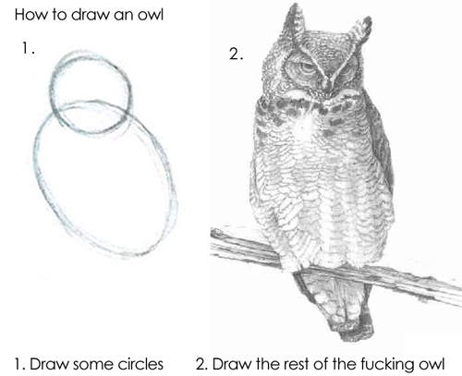
15 minute analysis: simple examples
Owl
Notes:
Many tutorials and program examples are like this drawing
In programming the 2 circles is equiv. to print “hello world” examples given to learn a language
The owl is equiv to building a complex interactive bells and whistles program without being given the intermed. Steps
This talk will give two circles and add a couple of feathers but should be enough to show how our specific data can be ingested, analyzed and plotted

Slide 6
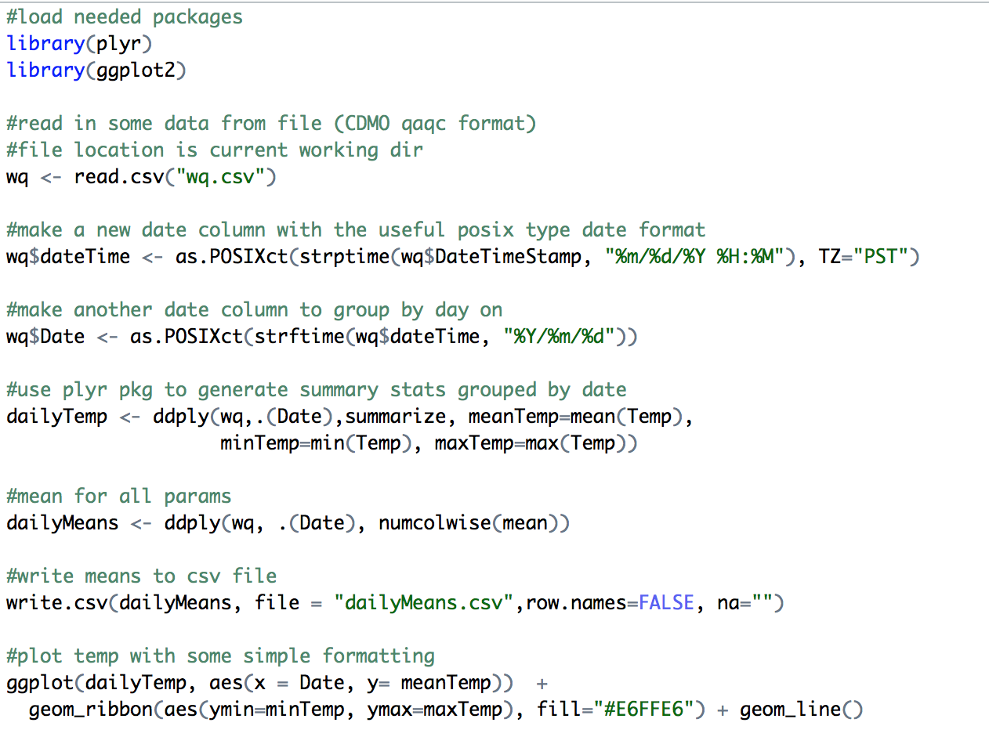
15 minute analysis: R simple example
Notes:
Code shown in simple code editing environment
In example:
- Load needed libraries first thing
Read a sample water quality data file as it is formatted using the CDMO QAQC macro
Massage time stamps as CDMO times are not ISO format
Aggregate data
Output file
Plot anayalized data
Analysis in example is an aggregation to summarize data at different frequencies (hourly, daily etc) as people expressed interest in this though many many more complex routines are available through different libraries
Note: These are bones examples
does not show how to program using best practices , advanced data input, error handling , user input etc..

Slide 7
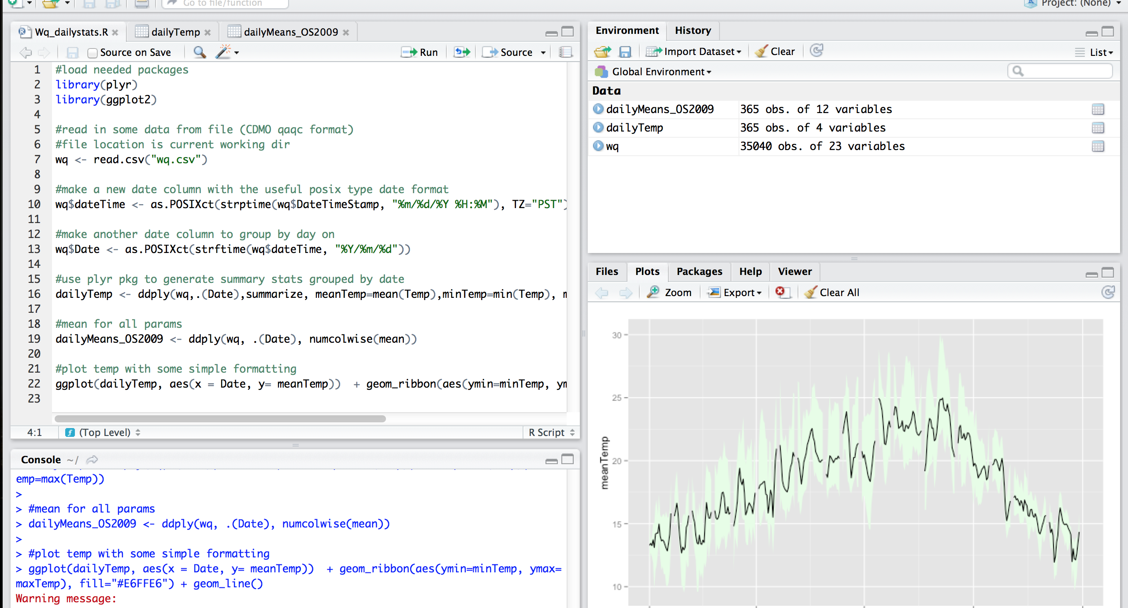
15 minute analysis: R simple example
Notes:
Same example in Rstudio
code pane, plot pane, file views etc….

Slide 8
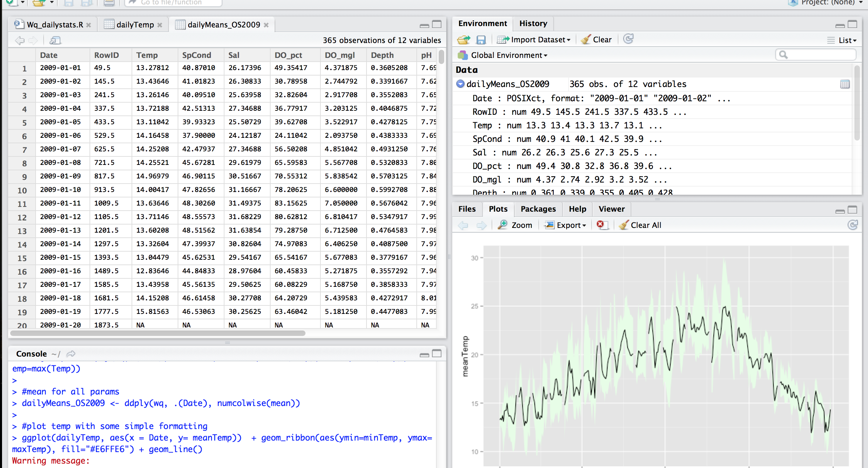
15 minute analysis: R simple example
Notes:
File view – similar to a spreadsheet, makes looking at data very easy using Rstudio!

Slide 9
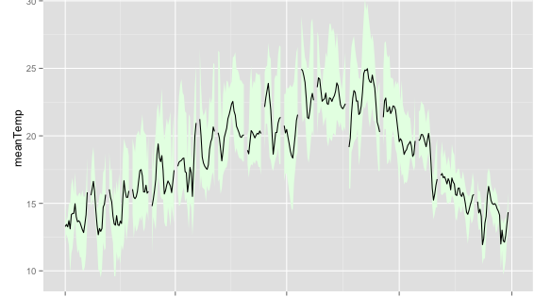
15 minute analysis: R simple example
Notes:
Can export plots in various file types, though viewer is less interactive than the python plot viewer.

Slide 10
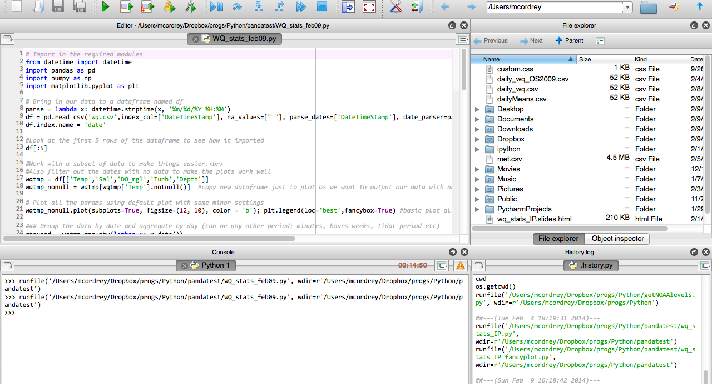
15 minute analysis: Python example
Notes:
Similar aggregation analysis using python
This example goes a bit further than the R example as I usually work in python and fleshed out this one first but did not have time to finish the R to the same level.

Slide 11
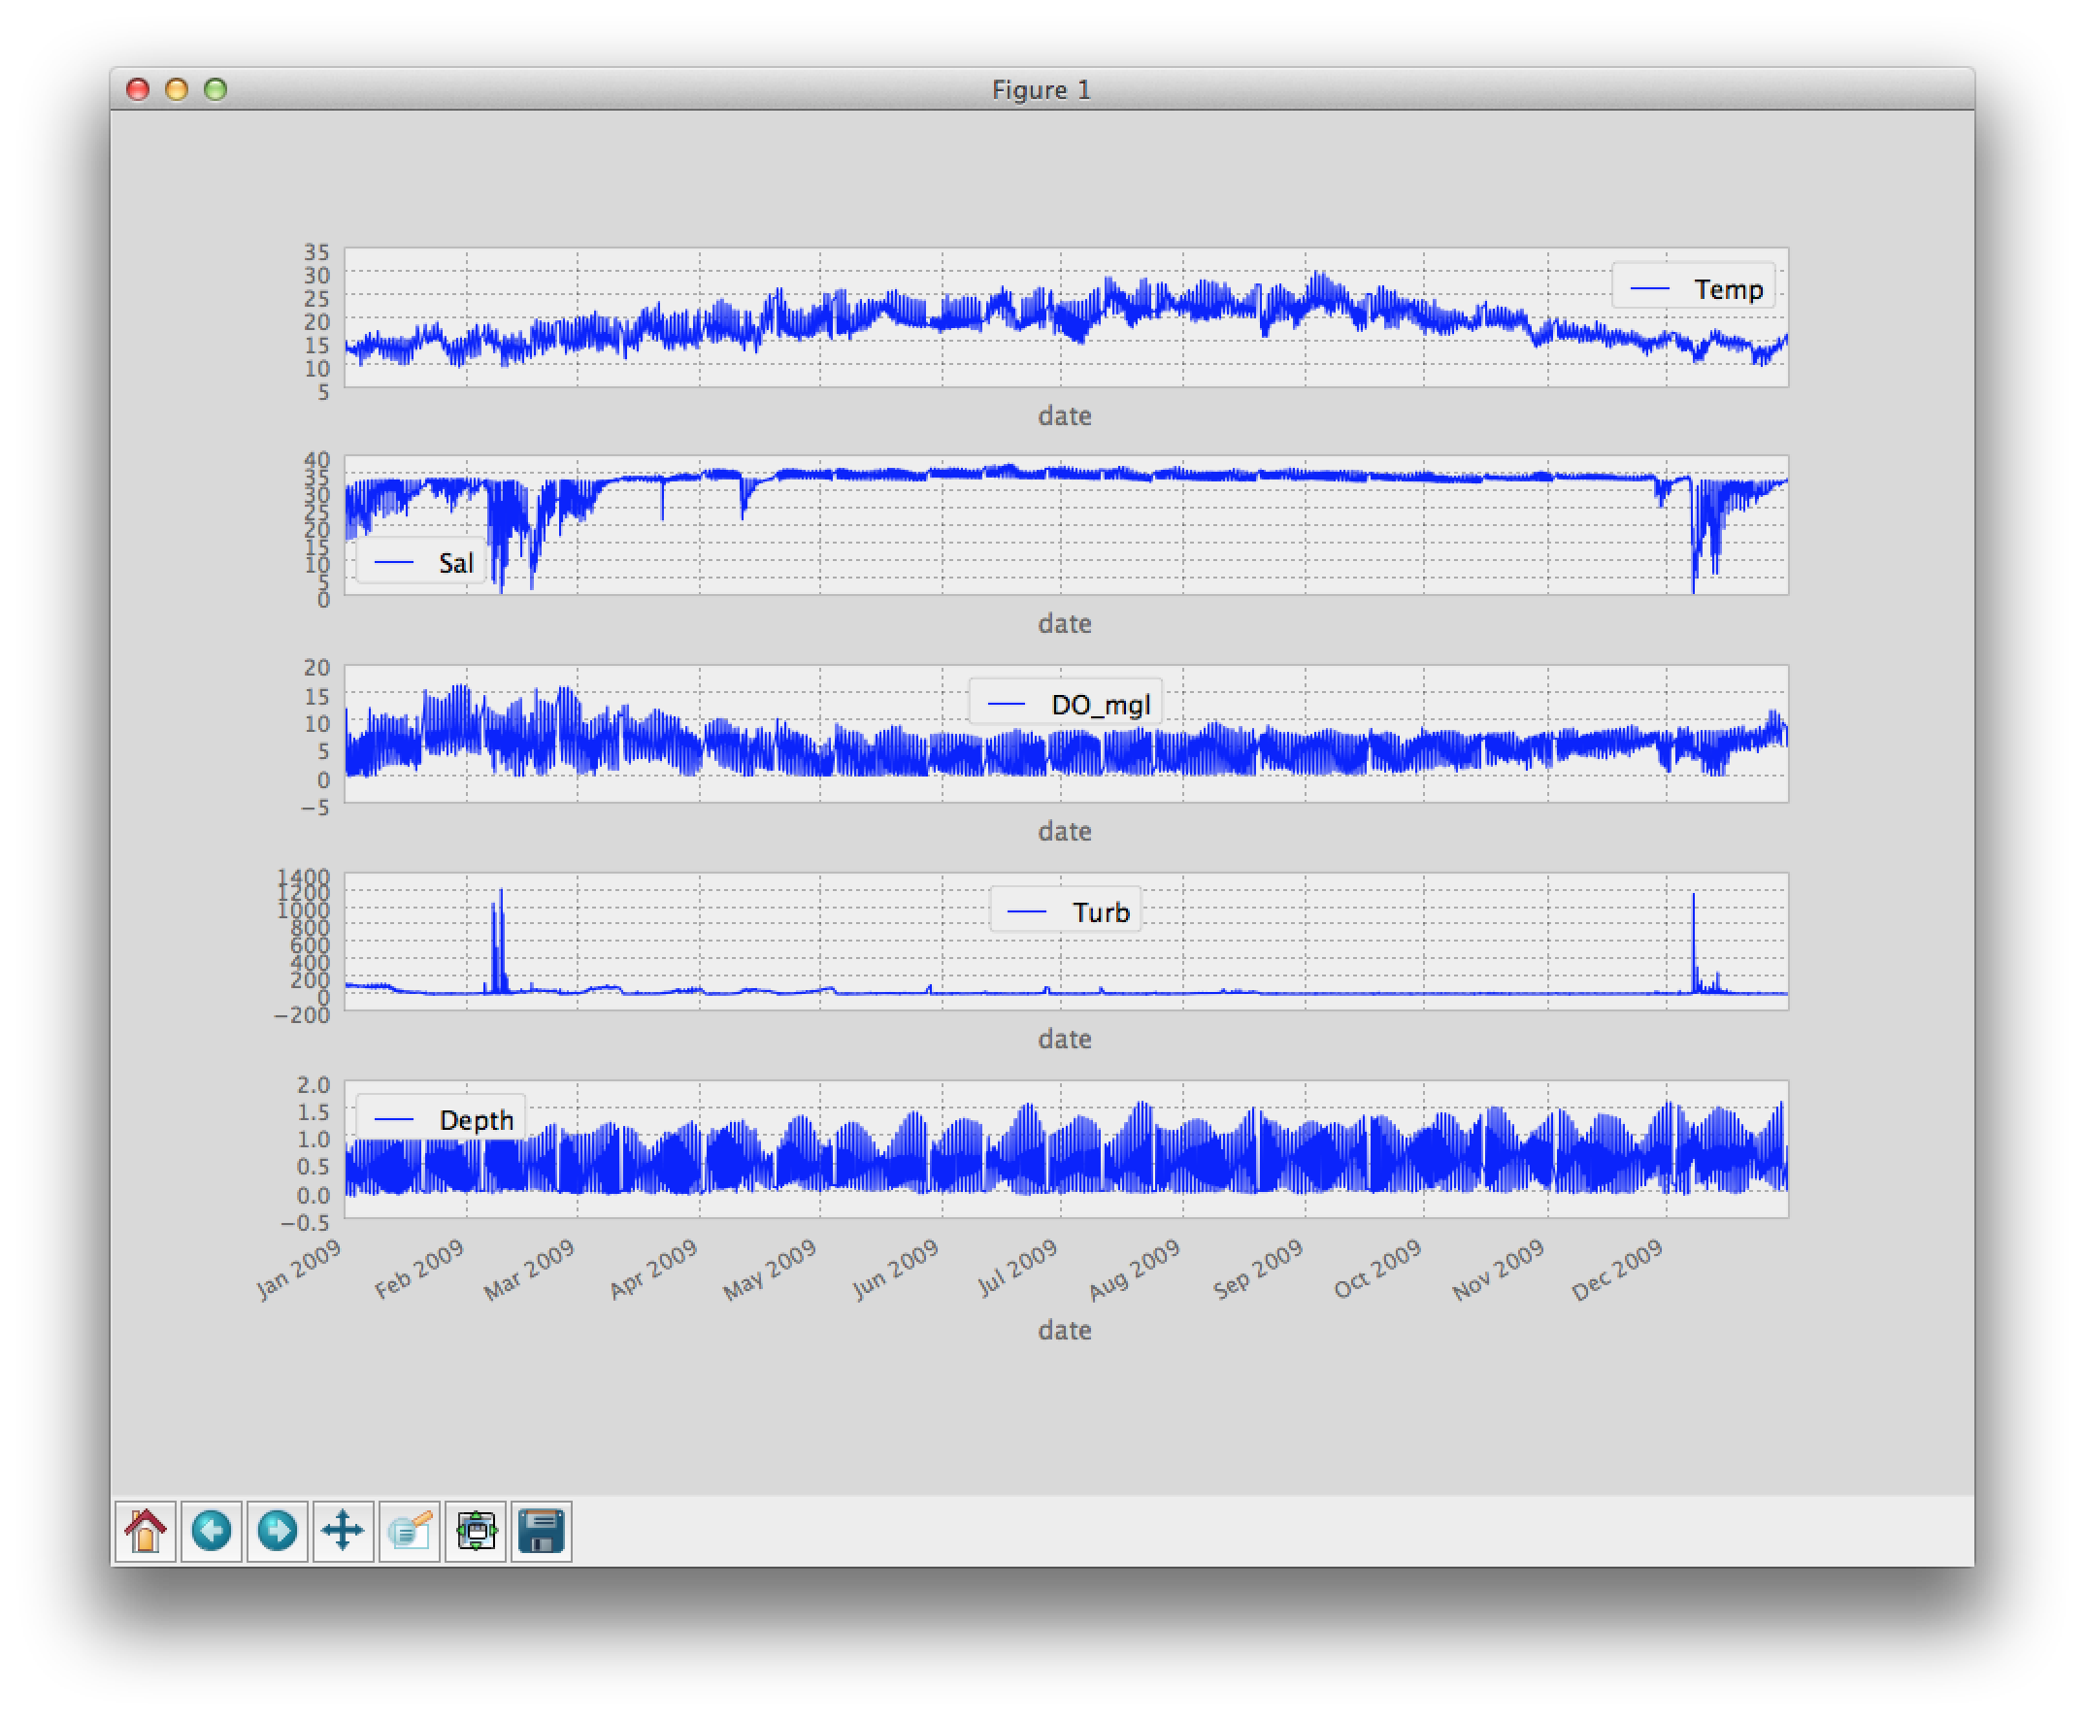
15 minute analysis: Python example
Notes:
Shows interactive plotting environment can change some very basic things in plots

Slide 12
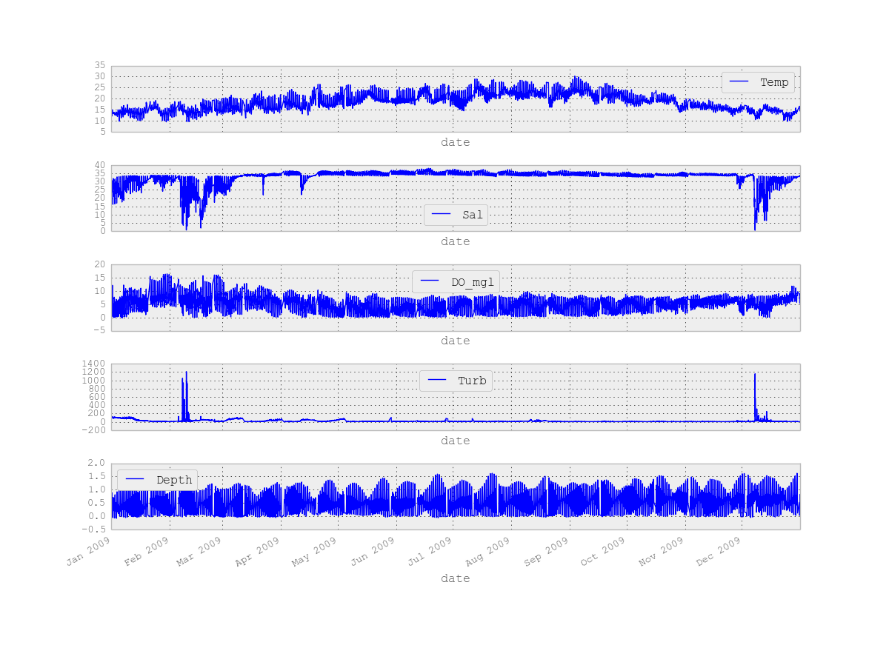
Notes:
Shows exported file to be embedded in a report etc

Slide 13
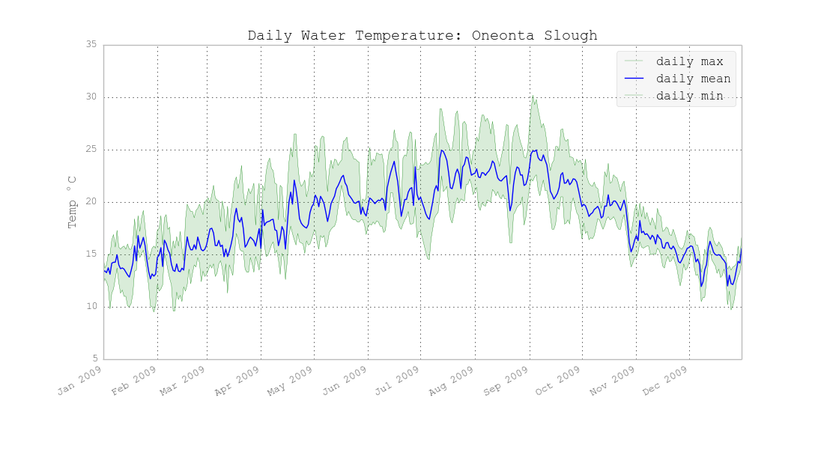
15 minute analysis: Python example
Notes:
Plot adding some customized formatting to make it pretty and more useful

Slide 14
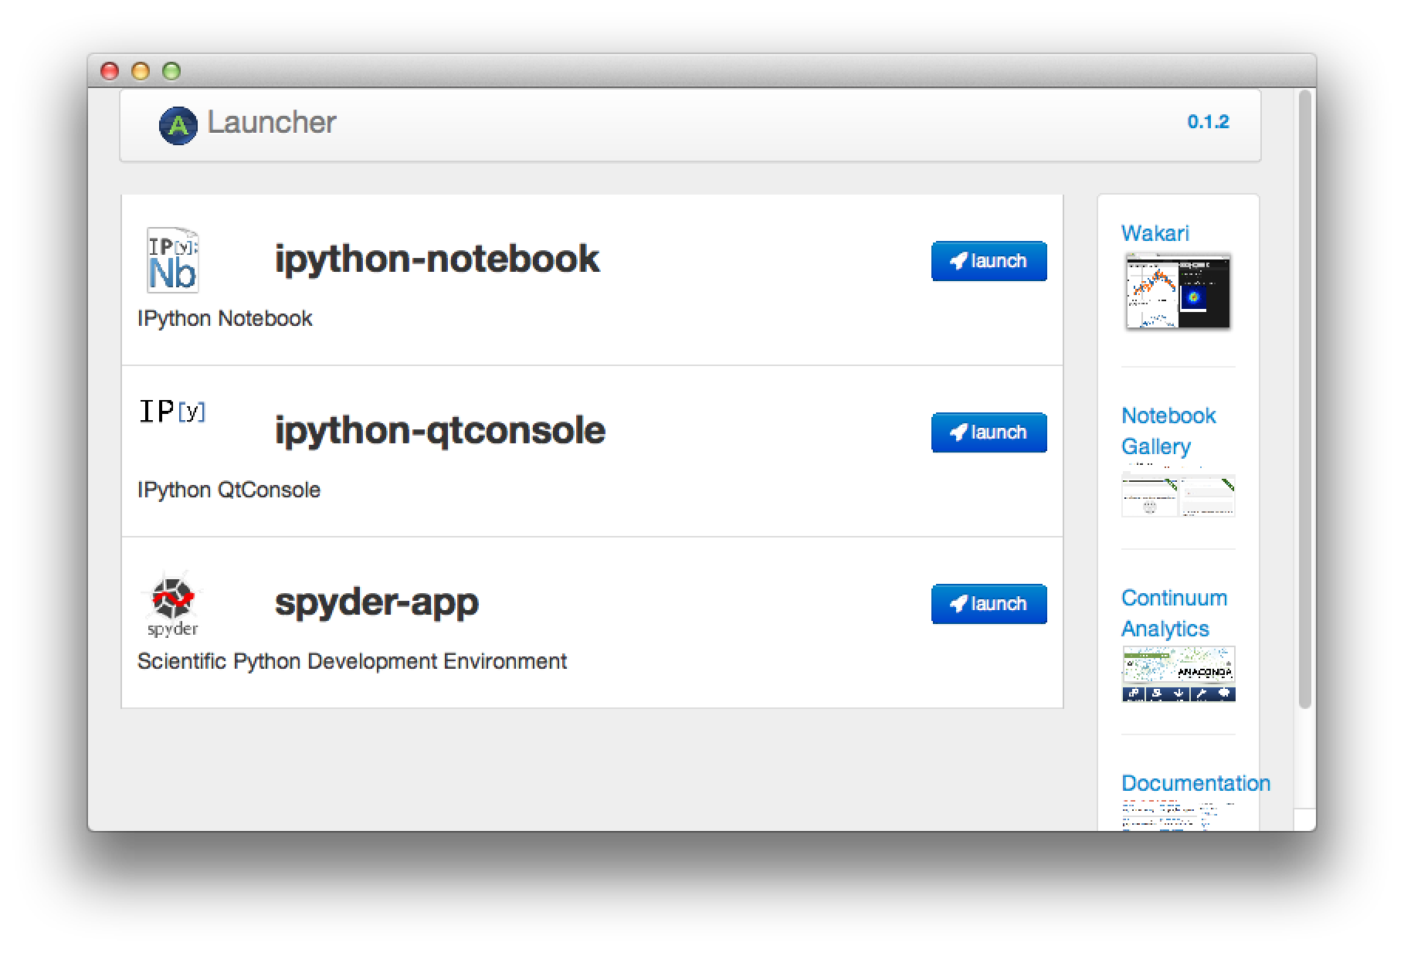
15 minute analysis: Python example
Notes:
Anaconda package launcher screen shows different environments in which to work with python
Will show ipython

Slide 15
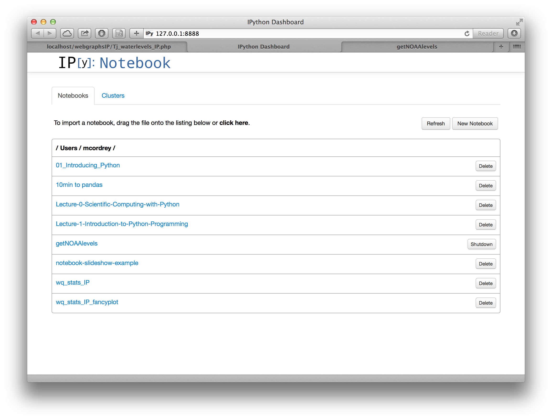
Notes:
Ipython shows programs as a list of “notebooks”
This is a great way of using python to collaborate with others or to work out separate portions of a program and take notes along the way. Each notebook can be exported as raw python code, a pdf or a slideshow

Slide 16
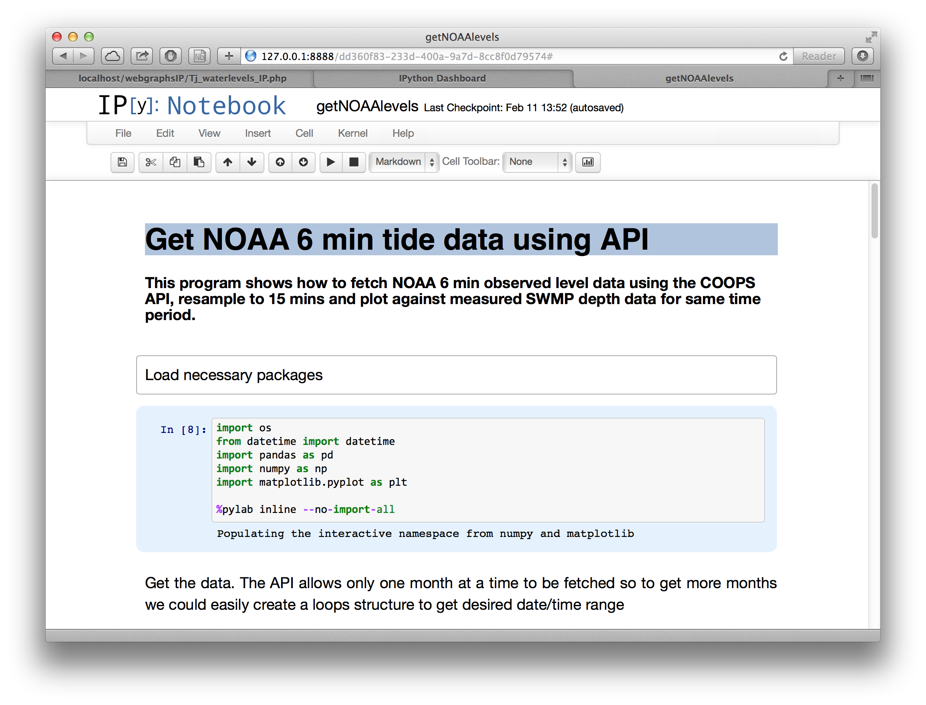
Notes:
Shows an ipython notebook I made
Notebook gets 6 min NOAA level data from a gauging station and plots it against SWMP data

Slide 17
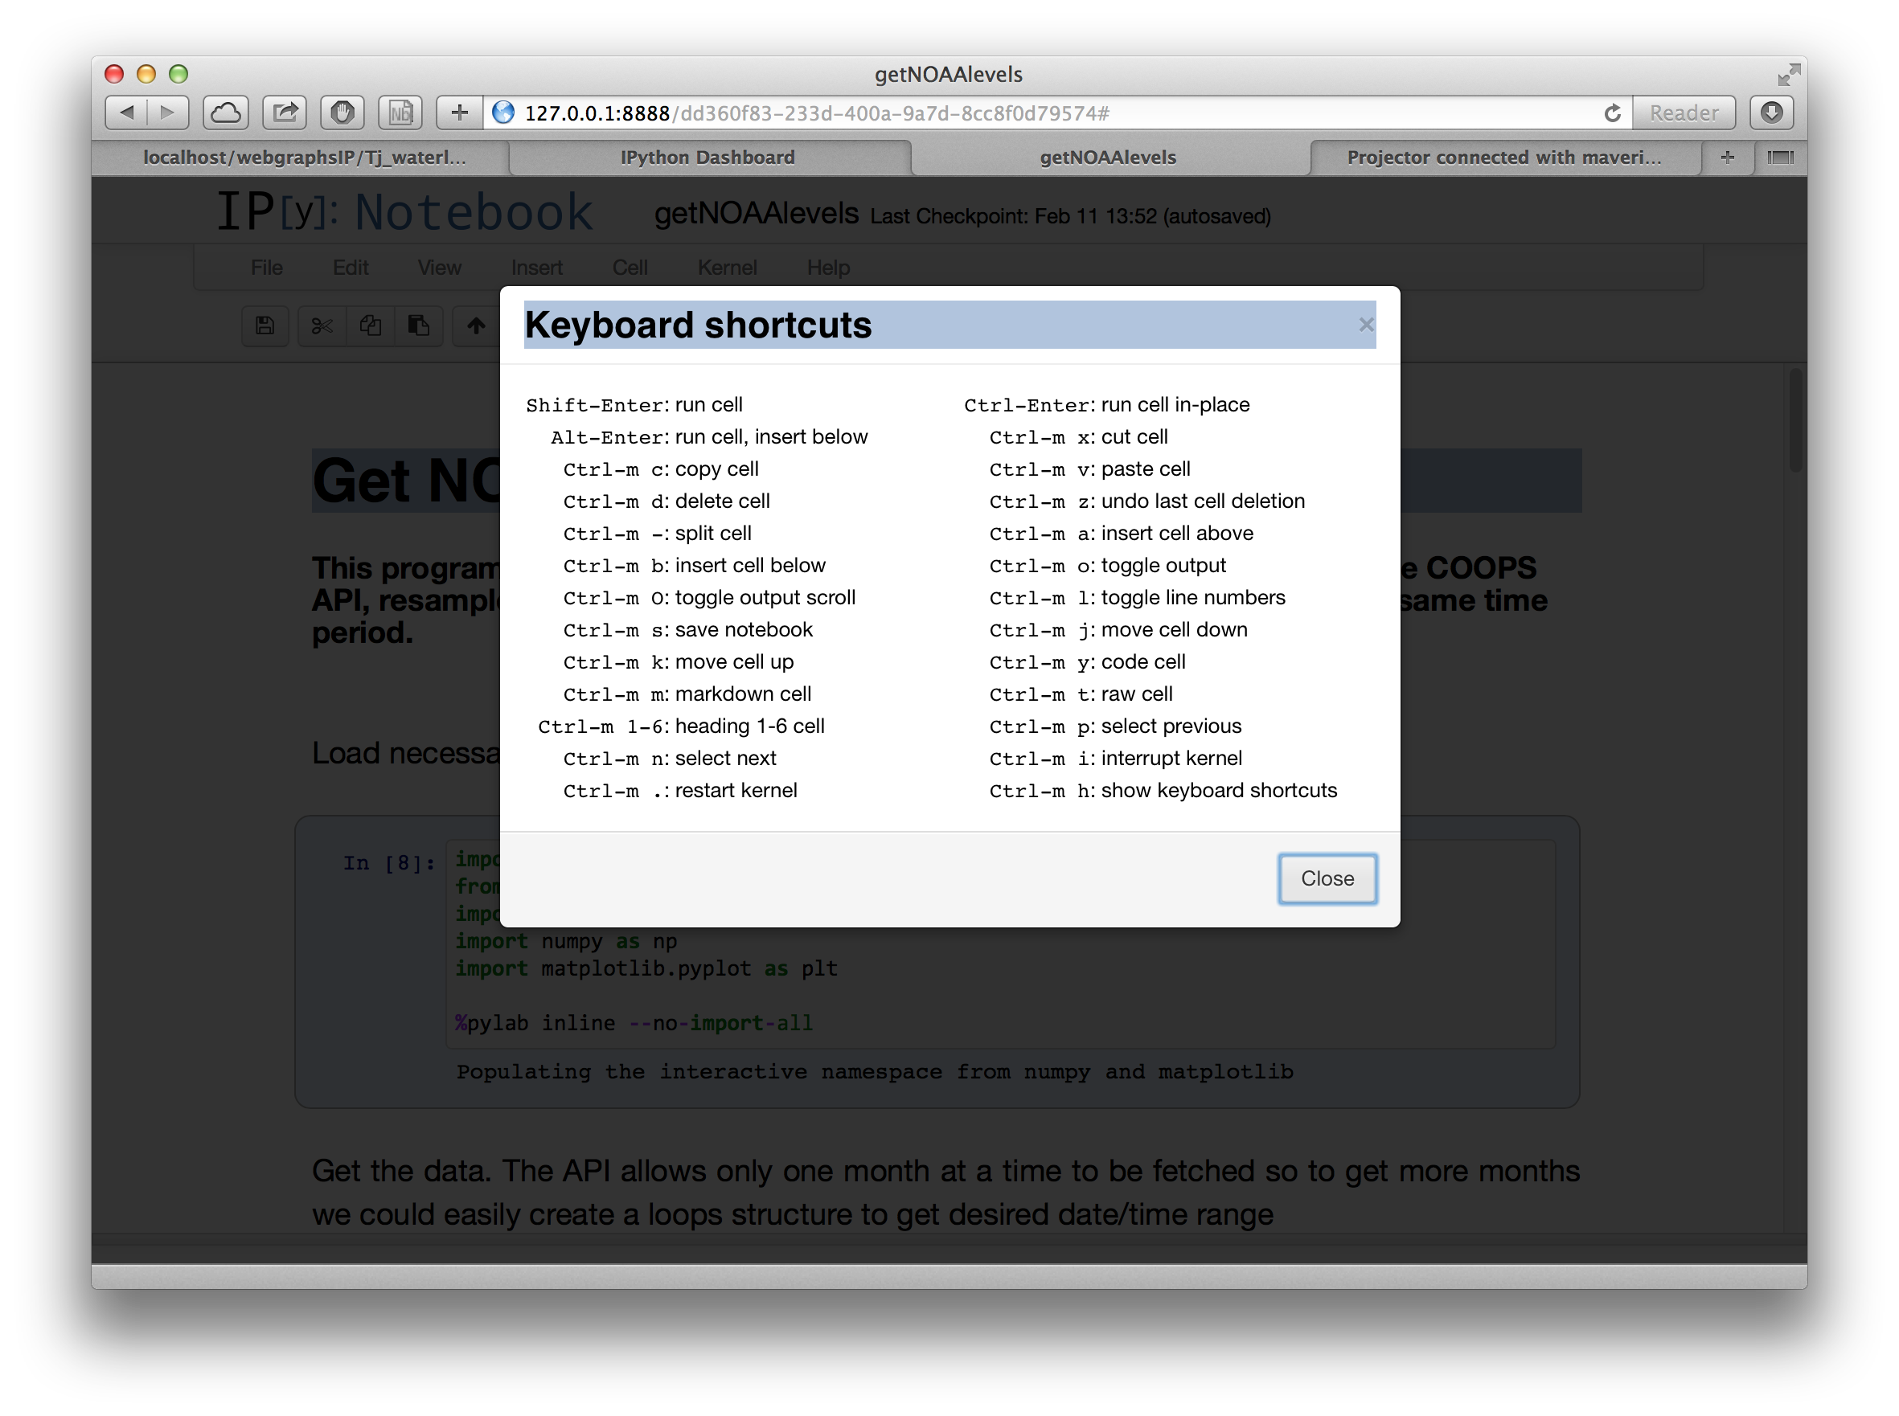
Notes:
Shows keyboard short cuts available in ipython to help workflow

Slide 18
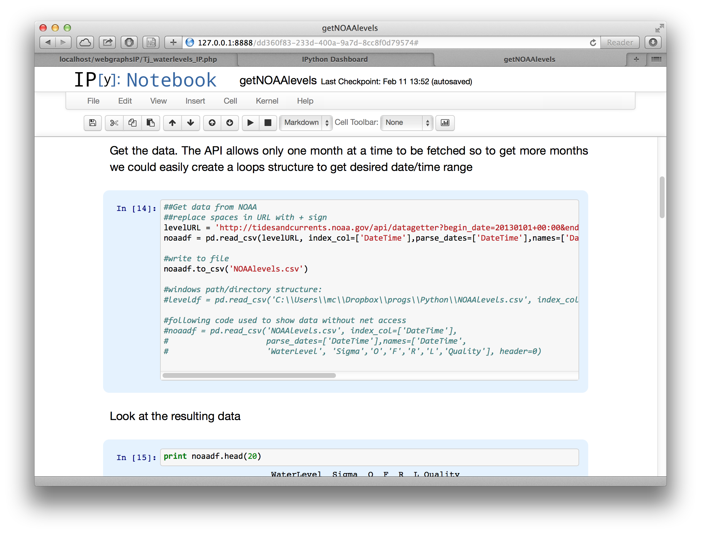
Notes:
Shows that notes are formatted differently from code and outputs of the code.
Ordered in a series of cells , each cell is interactive code and will show output if any below it
- this is great for working through each segment of code to get it working before moving on to next

Slide 19
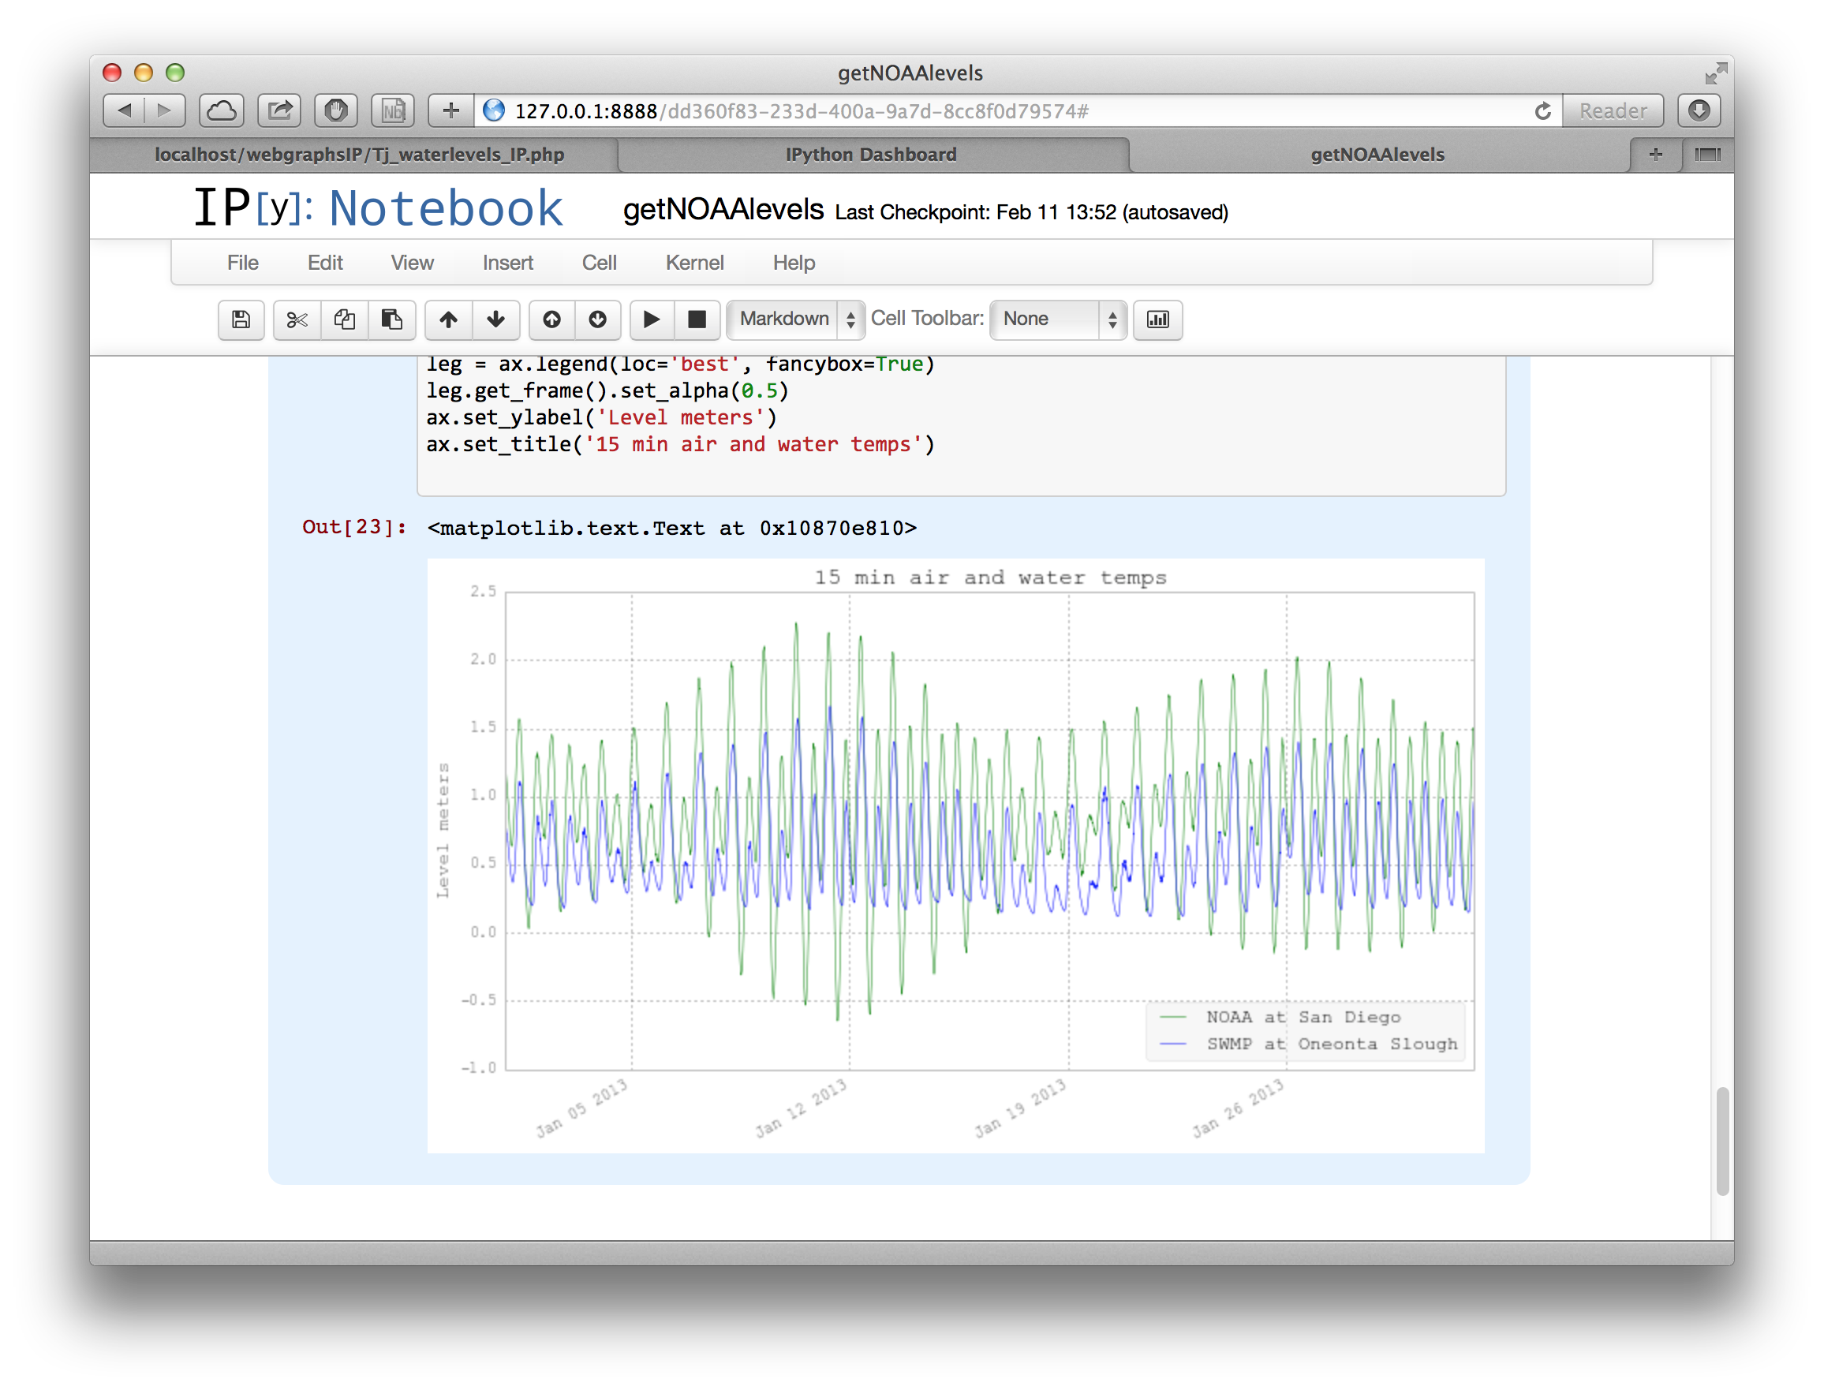
Notes:
Show plot output below cell. Can set to plot graphics externally (e.g. not inline mode)

Slide 20
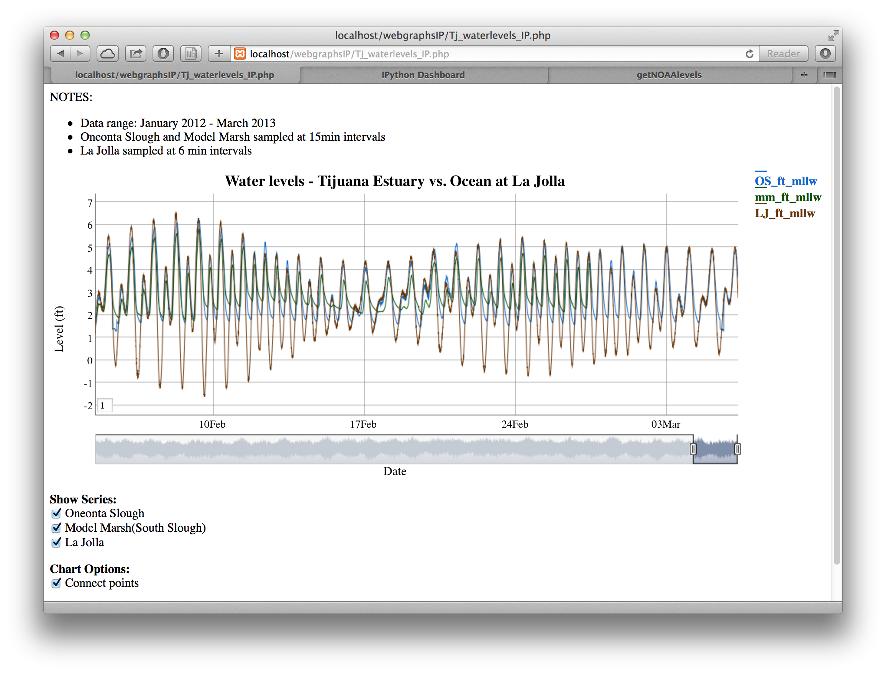
Notes:
Shows a realtime website that does similar as the ipython notebook
Can take working R or python local code and make it into a website with interactivity

Slide 21
Resources
Python
  Install Anaonda: https://store.continuum.io/cshop/anaconda/
R
  Install R: http://cran.r-project.org
  Install Rstudio: http://www.rstudio.com
All code used in the will be at:
http://trnerr.org/opensourcetools/
Notes:
Tips – some code changes needed depending on environment used – inline graphs , print out tables etc..
More advanced techniques:
multiple years / sites by reading from a directory and looping through all files in directory
interactive selection of files etc
error handling
My email: mcordrey@trnerr.org

